Slide 1
Tailwind CSS Essentials for Developers
Kevin Griffin
kevin@consultwithgriff.com | consultwithgriff.com
twitter.com/1kevgriff

Slide 2
Let’s start with some code

Slide 3

Hey there!
Kevin Griffin
12x Microsoft MVP
ASP.NET Core, Azure, and Web
consultwithgriff.com
twitter.com/1kevgriff
twitch.tv/1kevgriff

Slide 4
If CSS has an API…

Slide 5
If CSS was in plain English…

Slide 6
Installation and Setup
Skipping this as a convenience
https://tailwindcss.com/docs/installation for all the information

Slide 7

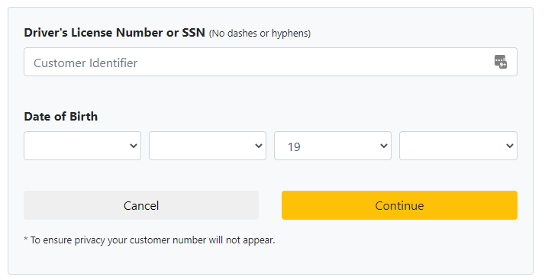
We don’t talk about Bootstrap…
First, Bootstrap is still an okay solution
But all Bootstrap sites look the same

Slide 8
We don’t talk about Bootstrap…
Bootstrap (and Bootstrap templates) don’t give you much flexibility without overhauling CSS
A lot of components require JavaScript to work appropriately.

Slide 9
We don’t talk about Bootstrap…
Let’s not judge Tailwind CSS and Bootstrap as equals – they are not.

Slide 10
We have a lot to cover!
Layout
Sizing
Colors
Typography
Variants
Responsive Design
Performance / Deployment
Frameworks Support
Extra

Slide 11
I’m glossing over A LOT of material
https://tailwindcss.com/docs

Slide 12
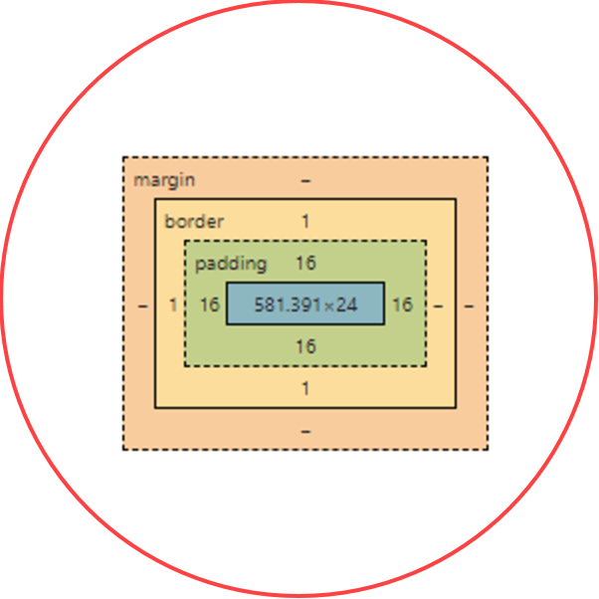
Layout
The Box Model

Slide 13
Box Model Helpers
<div></div>

Slide 14
Box Model Helpers
<div class=“p-5”>
</div>

Slide 15
Box Model Helpers
<div class=“pt-5”>
</div>

Slide 16
Box Model Helpers
<div class=“pb-5”>
</div>

Slide 17
Box Model Helpers
<div class=“pl-5”>
</div>
<div class=“pr-5”>
</div>

Slide 18
Box Model Helpers
<div class=“px-5”>
</div>

Slide 19
Box Model Helpers
<div class=“py-5”>
</div>

Slide 20
Box Model Helpers
<div class=“m-5”>
</div>

Slide 21
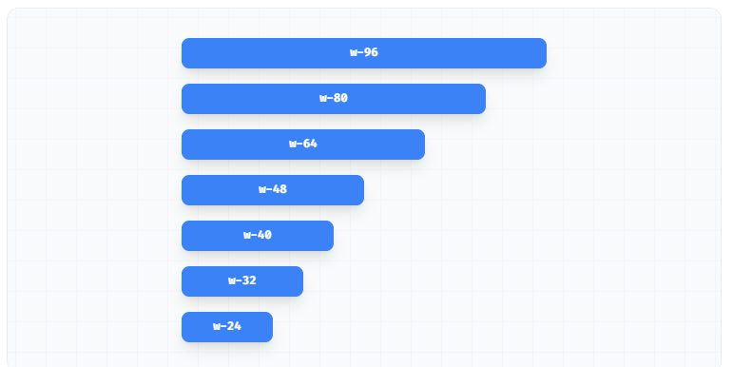
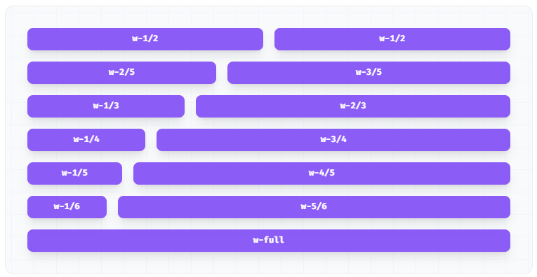
Widths

Slide 22
Let’s dive into some examples!

Slide 23
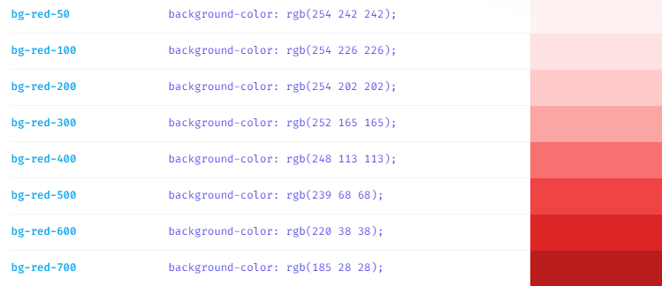
Colors

Slide 24
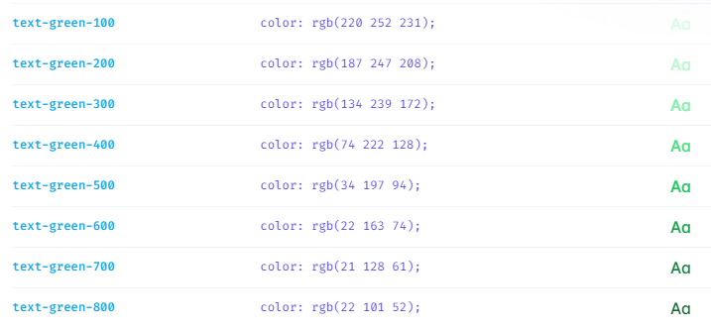
Colors

Slide 25
Custom attributes

Slide 26
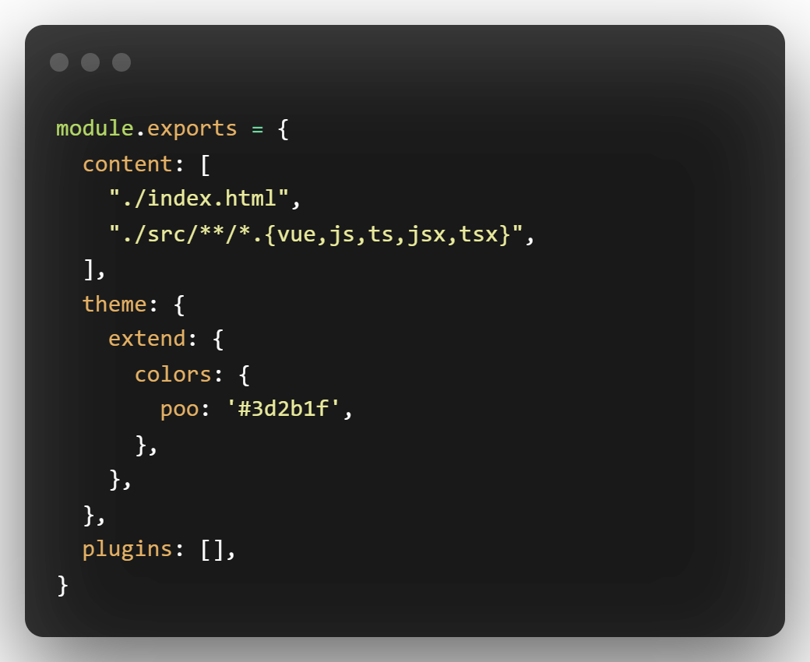
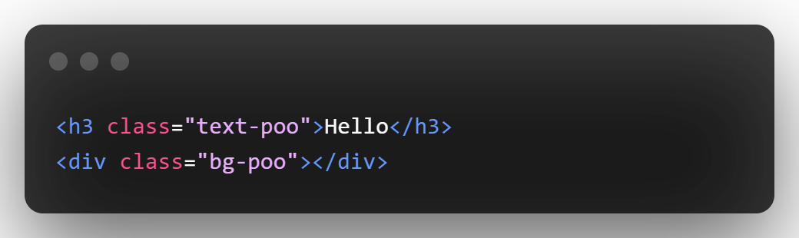

Custom Attributes

Slide 27
Variants

Slide 28
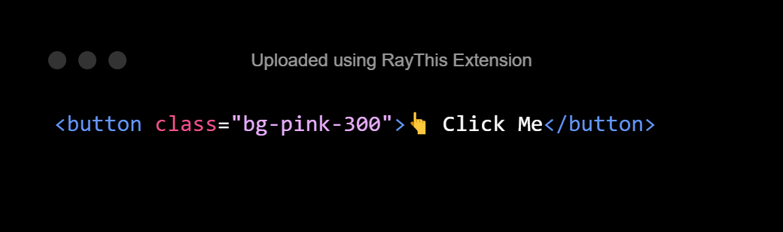

Variants (hover, active, disabled)

Slide 29
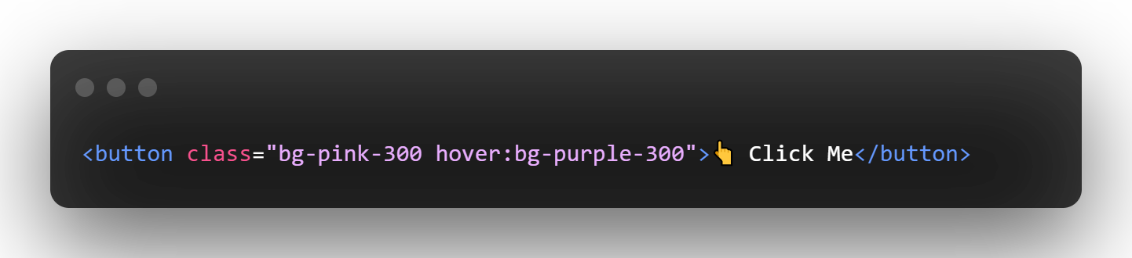

Variants (hover, active, disabled)

Slide 30
Speed Round
Let’s design some buttons

Slide 31
Custom Components
Or “that button CSS is very verbose”

Slide 32
Responsive Design

Slide 33
Performance and Deployment

Slide 34
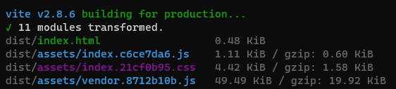
Performance and Deployment
Tailwind is designed to be a part of a build system
This include automatic tree shaking – no unnecessary CSS
The build grows only when you use more!

Slide 35
Framework Support

Slide 36
Thanks for coming!
Kevin Griffin
12x Microsoft MVP
ASP.NET Core, Azure, and Web
consultwithgriff.com
twitter.com/1kevgriff
twitch.tv/1kevgriff

